Slide 1
St Vincent’s J&P Water Project
Phase 2
The Liverpool Connection
Notes:
The history of Liverpool can be traced back to 1190 when the place was known as ‘Liuerpul’, possibly meaning a pool or creek of muddy water. Our city’s history and development is inextricably linked to its position as a west facing seaport – with the most important links to Africa and the slave trade, at its height in the 1790s, and to Ireland, particularly during the Famine years in the late 1840s, but before and after that. So, water and all it represents is ‘in our blood’ We want to share with you something about two people in the more recent history of Liverpool – Kitty Wilkinson and Dr William Duncan – both people who came to realise the importance of water in all our lives.

Slide 2
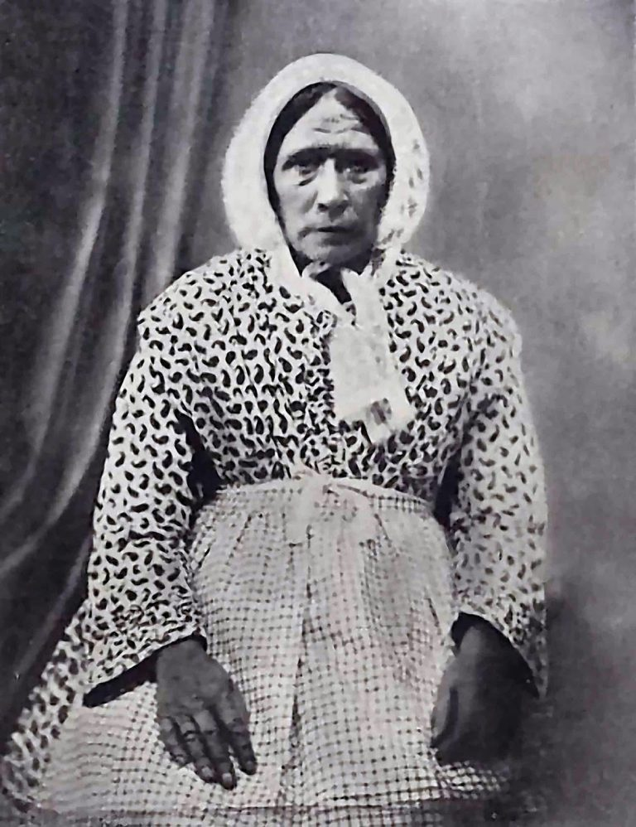
Kitty Wilkinson (1786-1860)
Notes:
Kitty Wilkinson was born in Co.Derry in Ireland. She came to Liverpool at the age of 9. Their ship ran aground in the Mersey and her father and younger sister were drowned. She became known as the ‘Saint of the Slums. In 1832 during a cholera epidemic she had the only boiler in her neighbourhood – which is our neighbourhood here around St Vincent’s church. She invited people to use her house as a washhouse with all important access to hot water to wash clothes and bedding, thus saving many lives.
She also took in homeless children and taught that cleanliness was the main weapon against disease.

Slide 3
Timeline
1832 Cholera epidemic hit Liverpool
1842 First public bath and wash house was built in Upper Frederick Street Liverpool 1
1860 first time houses were built with running water and toilets for the working classes
Notes:
Cholera was decimating the working classes as they had no access to clean hot water to wash their clothes and bedding to get rid of the disease. In the space of 10 years after much protest by Kitty and others the first public bath and wash house was built.

Slide 4
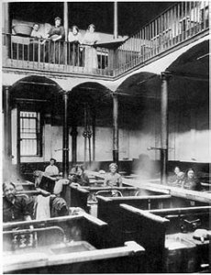
Frederick Street Wash House(1842)
Notes:
One of the earlier pictures of the Frederick Street washhouse

Slide 5
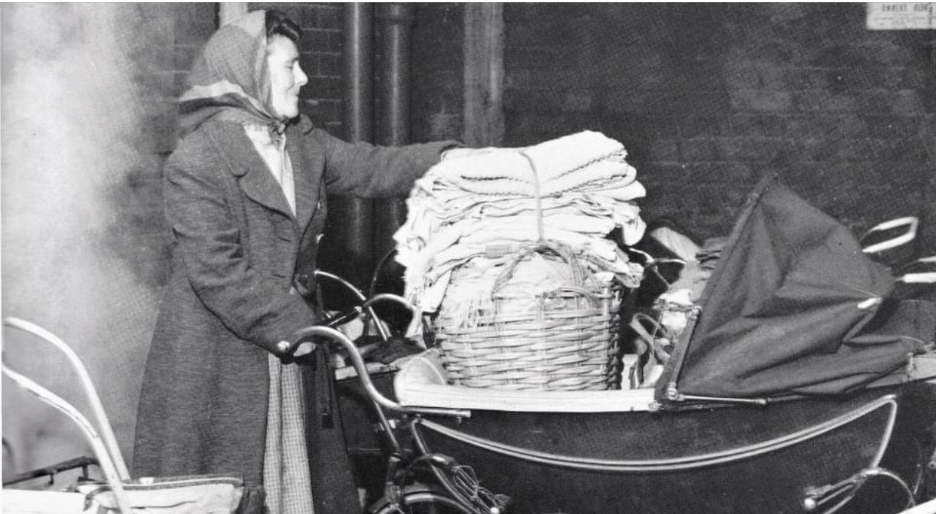
Going the Wash Houses
Notes:
Typical scene who many will remember the weekly trip with your Mum/Nan to do the weekly wash

Slide 6
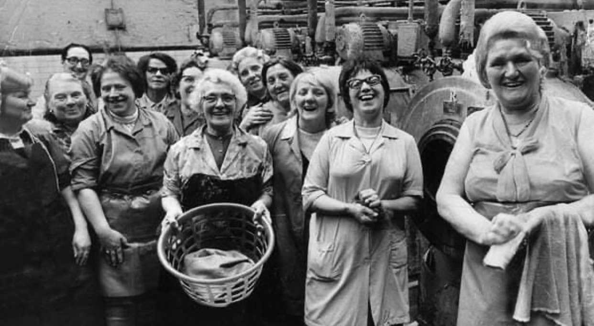
Wash House
Notes:
Note the big industrial machines but more importantly the happy camaraderie of the women

Slide 7
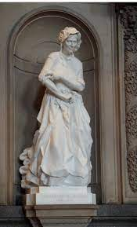
Kitty Wilkinson only female statue in St George’s Hall
Notes:
Such was the impact Kitty had on the social justice scene to allow clean hot water for people to wash their clothes and get washed that she was honoured in St George’s Hall and is in fact the only female statue in St George’s.

Slide 8
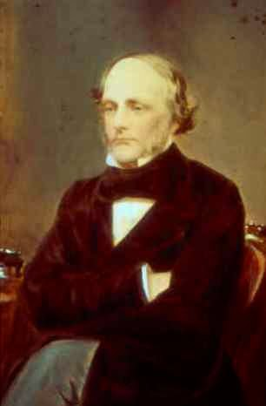
Dr William Duncan (1805 -1863)
Notes:
Born in Liverpool, studied medicine in Edinburgh, returned to practice medicine in his home city at a time when Liverpool was known as ‘The Black Spot on the Mersey’. In 1847 when Liverpool had a population of 25,000 – 5,845 people died of the ‘Fever’ and 2,589 died of ‘Diarrhoea’ – the highest mortality rate ever seen in Liverpool – a desperate time in our city’s history.

Slide 9
Dr Duncan
Dr William Duncan, the country’s first ever Medical Officer of Health
He took up his newly created role during a deadly epidemic of cholera that killed large numbers of the town’s population.
He was the first who had to fight for often unpopular measures, to change behaviour and improve the environment.
Notes:
Such was the success of Dr Duncan’s measures that the mortality rate in 1846 was 36 per 1000 and this went down to 28 per 1000 in 1860 thus saving the lives of 1000’s

Slide 10
…and so, as Kitty and Dr Duncan believed everyone should have the right to clean water, so we still need to fight for this today

